Slide 1

Lesson 6 – ROS - Assignment 1 Creating a 2D Map of an Unknown Environment by tutulebot3
Intelligent Mobile Robotics
Dr. Aboozar Taherkhani (PhD)
email: aboozar.taherkhani@dmu.ac.uk

Slide 2
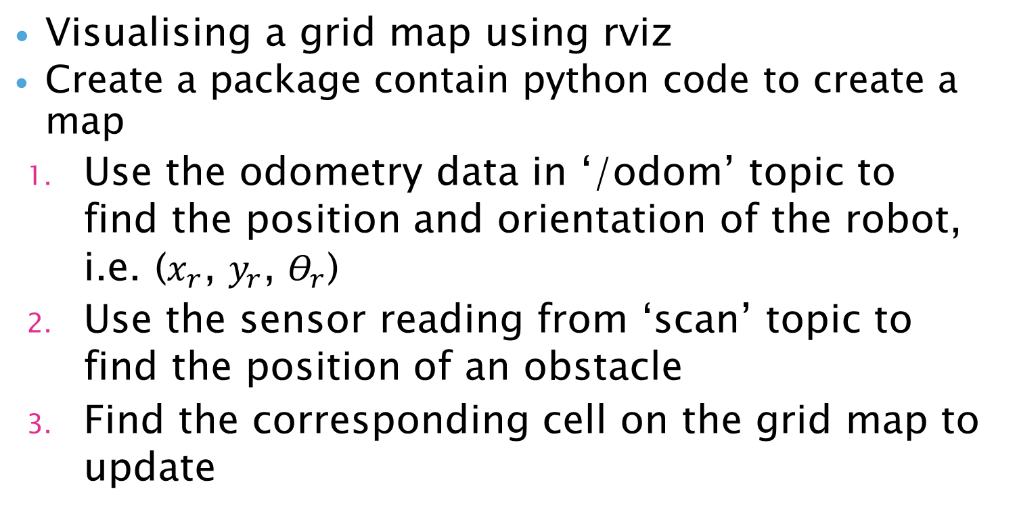
Overview
Visualising a grid map using rviz
Create a package contain python code to create a map
Use the odometry data in ‘/odom’ topic to find the position and orientation of the robot, i.e. ($x_{r}$, $y_{r}$, $Θ_{r}$)
Use the sensor reading from ‘scan’ topic to find the position of an obstacle
Find the corresponding cell on the grid map to update

Slide 3
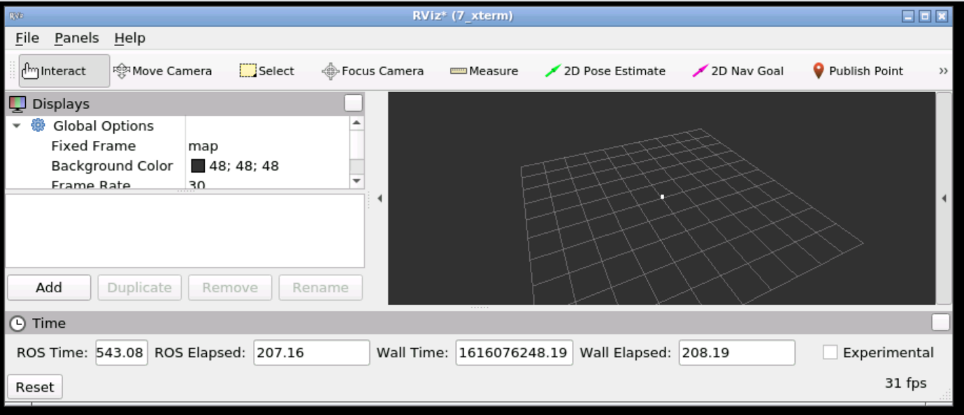
Visualising a grid map using rviz
Rviz, abbreviation for ROS visualization, is a powerful 3D visualization tool for ROS

Slide 4
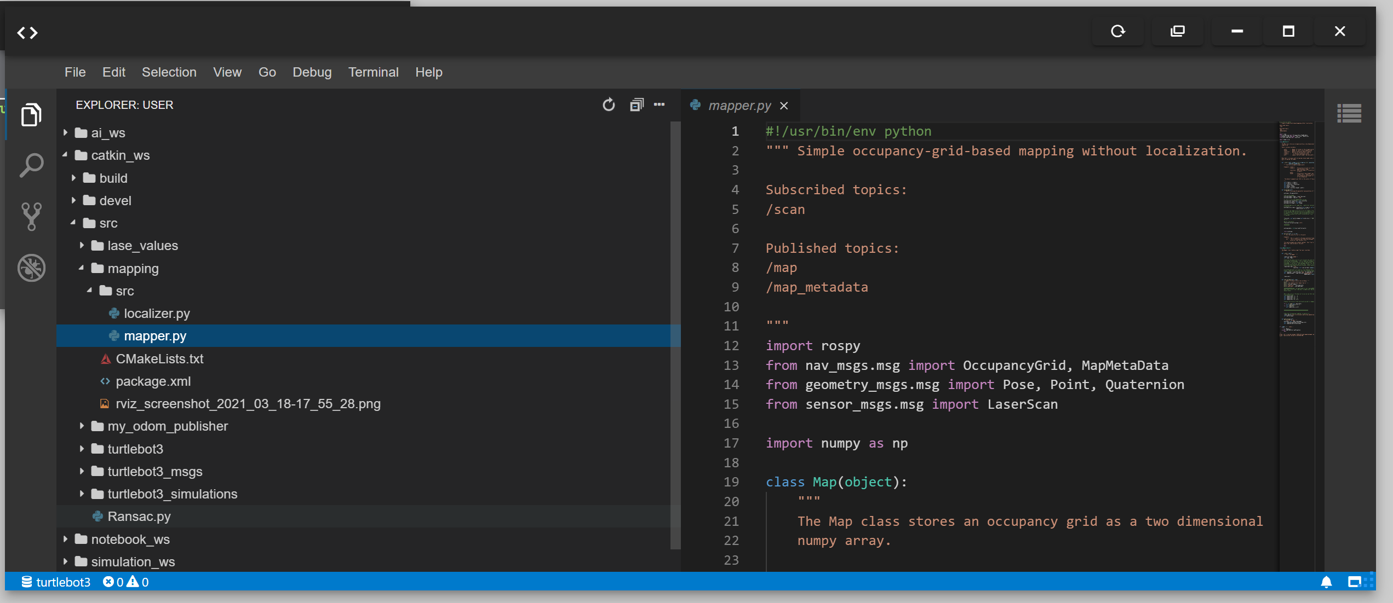
Create an empty package called ‘mapping’

Slide 5
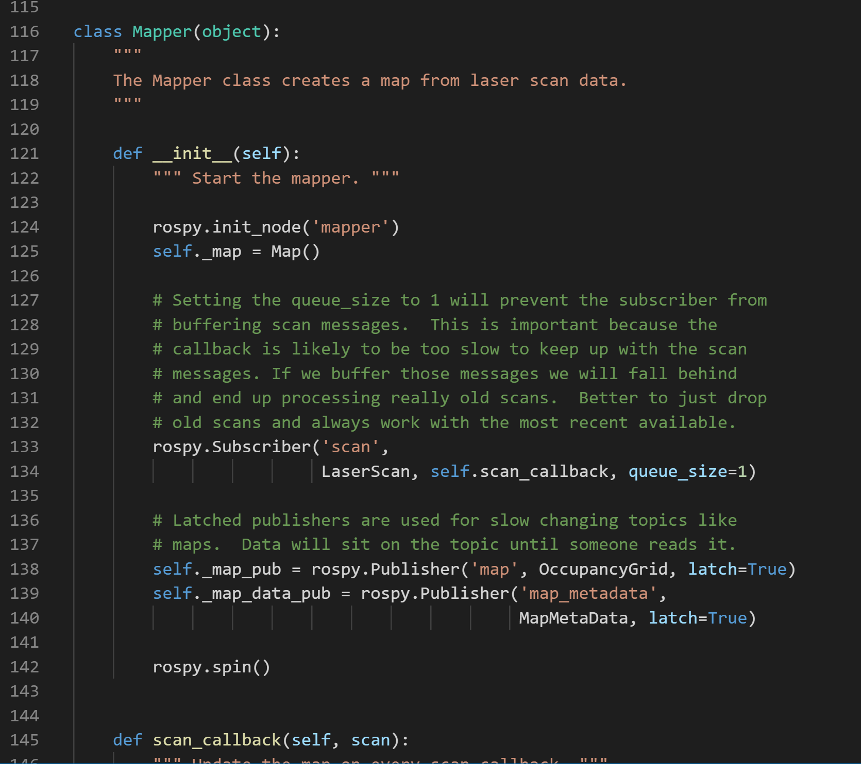
‘Mapper()’ class will create a map from laser scan data
Subscribes to ‘scan’ topic
its call back function is ‘self.scan_callback’

Slide 6
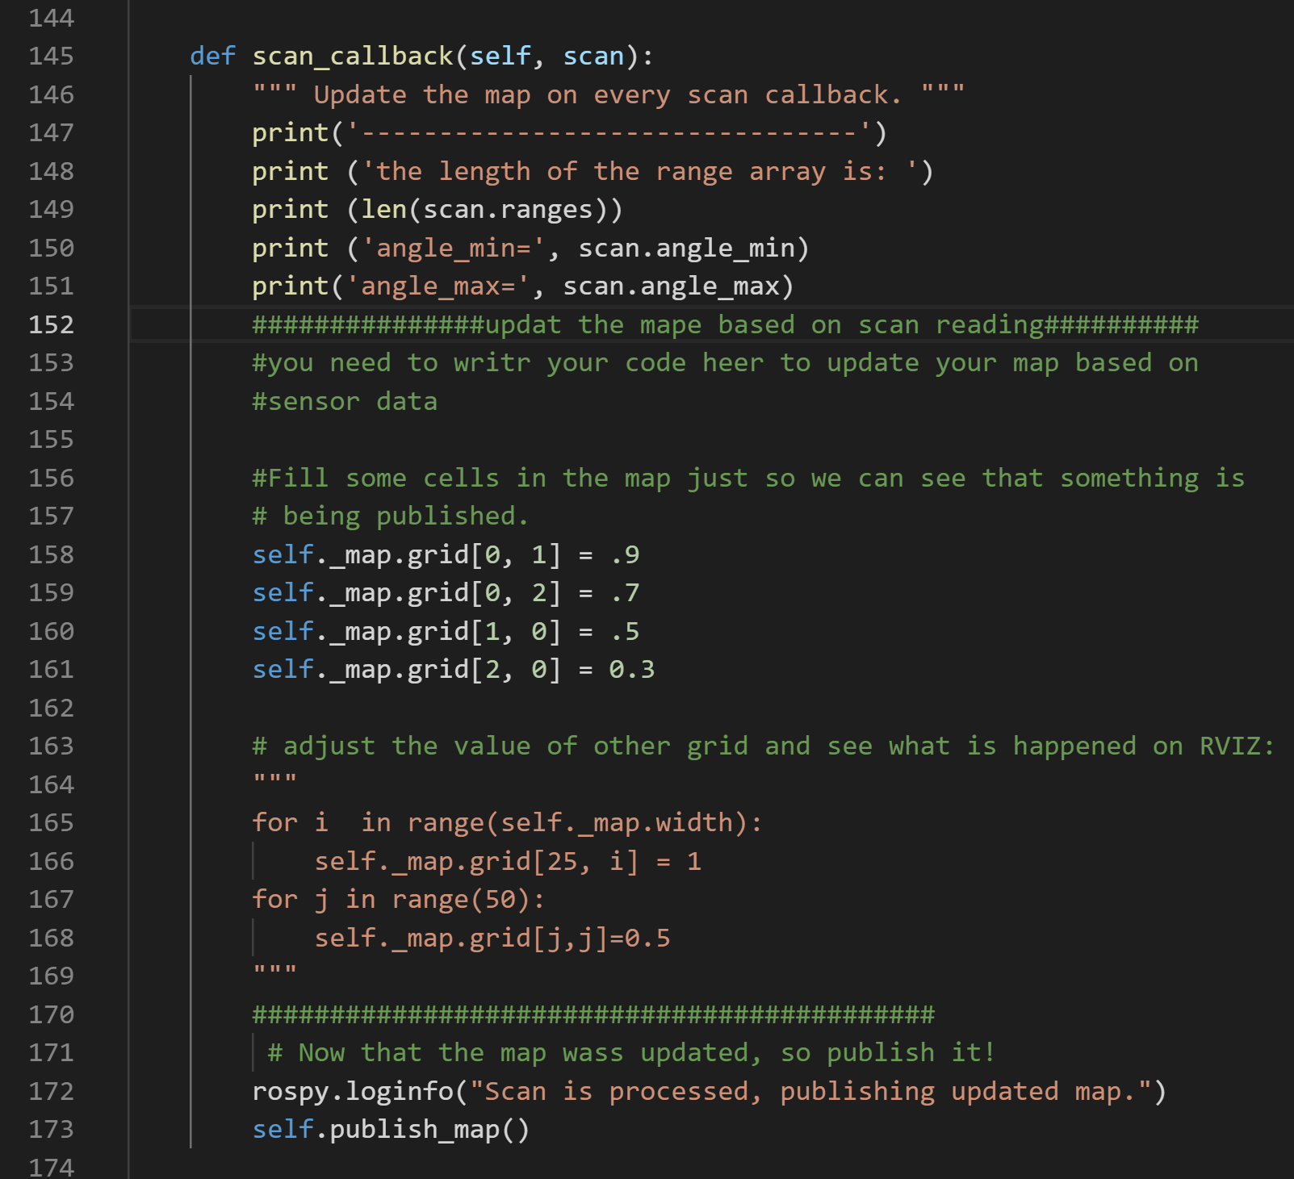
‘Mapper()’ class has a call back function: ‘self.scan_callback’
You could write your code in this function to plot on the map shown in rviz
Adjust the values of the grid cells, self._map.grid[i, j], and see what will happen on rviz

Slide 7

Creating a map
Use the odometry data in ‘/odom’ topic to find the position and orientation of the robot in a 2D global coordinate system, i.e. ($x_{r}$, $y_{r}$, $Θ_{r}$)
Use the sensor reading from ‘scan’ topic to find the position of an obstacle, i.e. ($x_{s}$, $y_{s}$)
Find the corresponding cell on the grid related to each obstacle, and change the probability of the cell on the grid map corresponding to the obstacle to 1

Slide 8
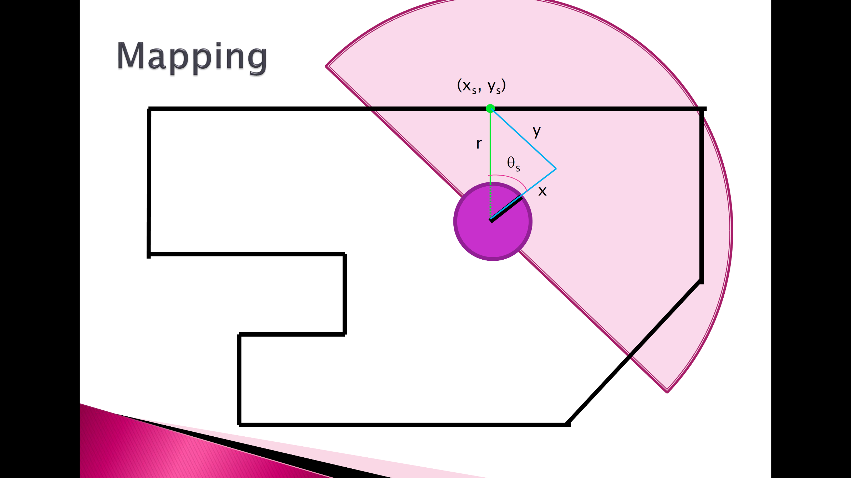
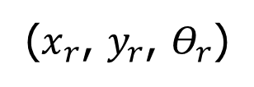
($x_{r}$, $y_{r}$, $Θ_{r}$)

Slide 9
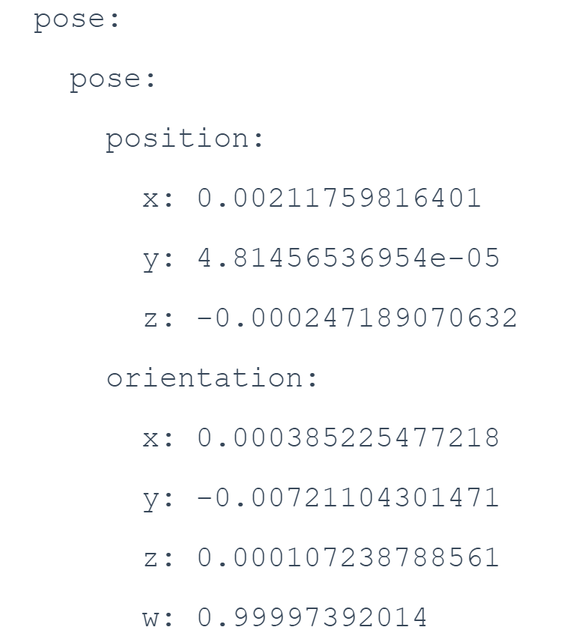

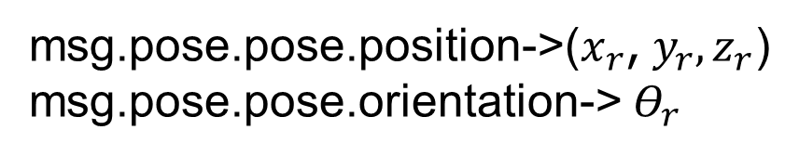
1-Use the odometry data in ‘/odom’ topic to find: ($x_{r}$, $y_{r}$, $Θ_{r}$)
Subscribe to the ‘/odom’ topic
sub = rospy.Subscriber ('/odom', Odometry, get_rotation)
msg.pose.pose.position->($x_{r}$, $y_{r},z_{r}$)
msg.pose.pose.orientation-> $Θ_{r}$

Slide 10
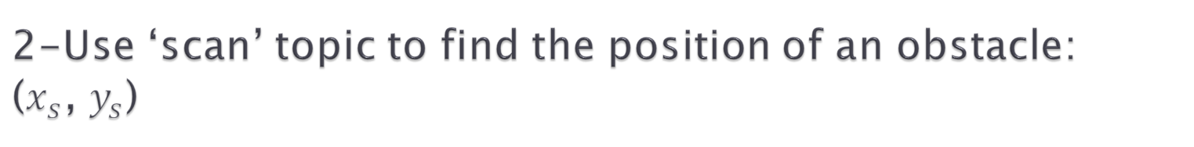
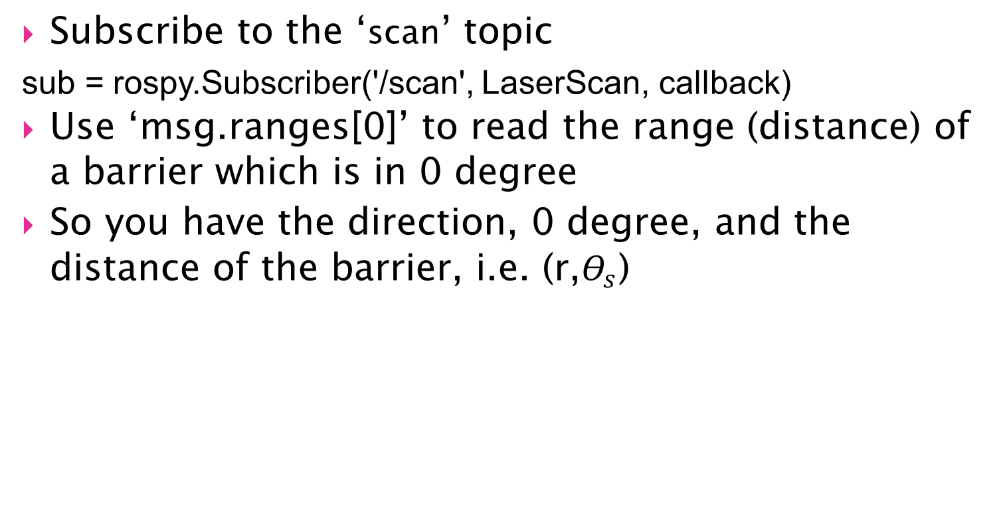
2-Use ‘scan’ topic to find the position of an obstacle: ($x_{s}$, $y_{s}$)
Subscribe to the ‘scan’ topic
sub = rospy.Subscriber('/scan', LaserScan, callback)
Use ‘msg.ranges[0]’ to read the range (distance) of a barrier which is in 0 degree
So you have the direction, 0 degree, and the distance of the barrier, i.e. (r,$Θ_{s}$)

Slide 12

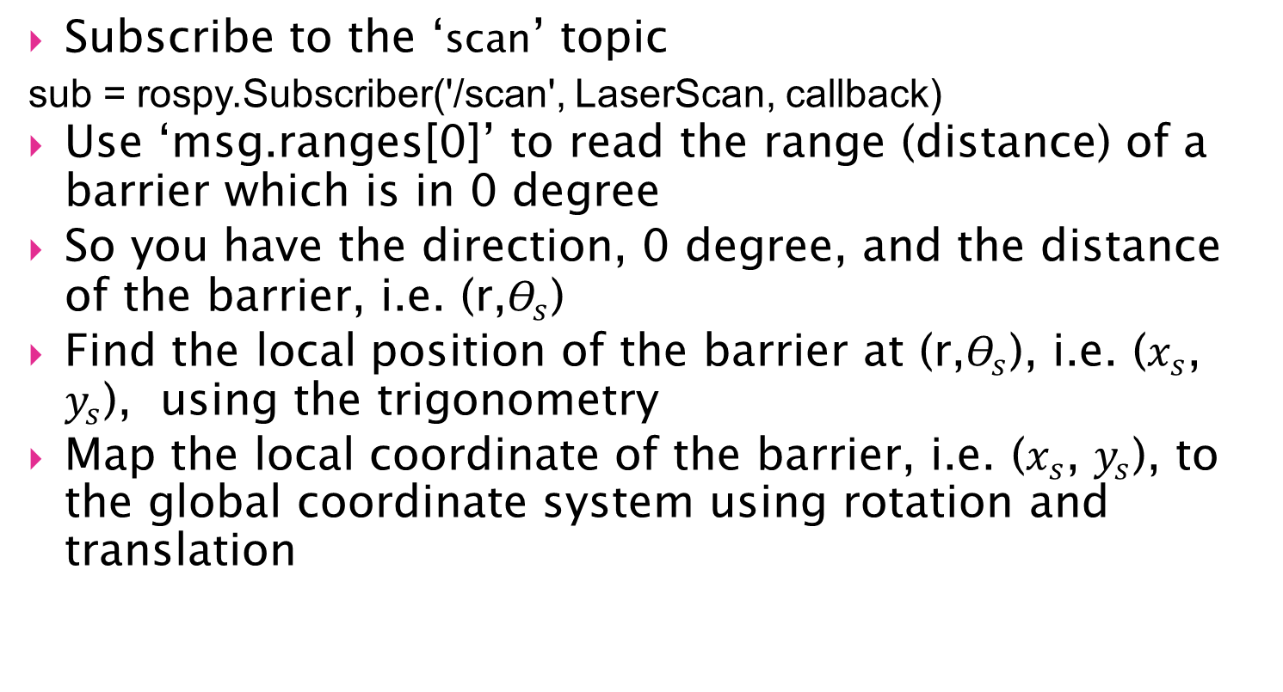
Use ‘scan’ topic to find the position of an obstacle: ($x_{s}$, $y_{s}$)
Subscribe to the ‘scan’ topic
sub = rospy.Subscriber('/scan', LaserScan, callback)
Use ‘msg.ranges[0]’ to read the range (distance) of a barrier which is in 0 degree
So you have the direction, 0 degree, and the distance of the barrier, i.e. (r,$Θ_{s}$)
Find the local position of the barrier at (r,$Θ_{s}$), i.e. ($x_{s}$, $y_{s}$), using the trigonometry
Map the local coordinate of the barrier, i.e. ($x_{s}$, $y_{s}$), to the global coordinate system using rotation and translation

Slide 13
Please see the lab sheet for Lesson 7 on LZ to work on this week practical
Lesson7- lab sheet- Creating a 2D Map of an Unknown Environment.pdf

